Slide 1
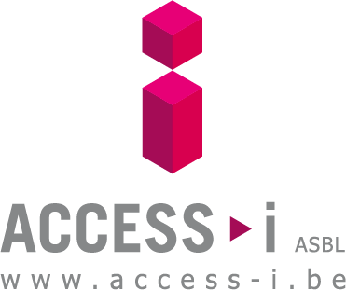
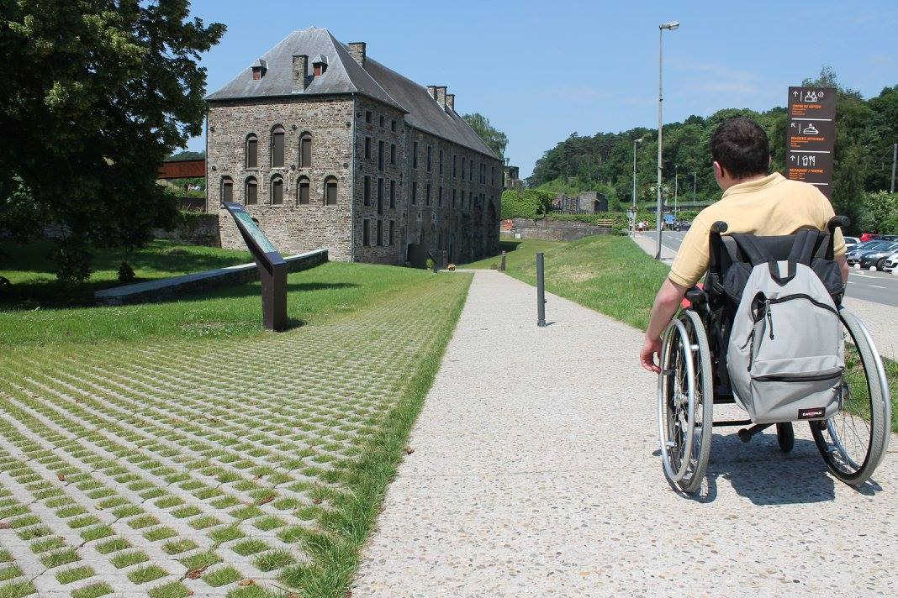

Label Week 2026

Slide 2
Evaluation
Information
Consulting
Our missions

Slide 3






1. Evaluation
Access-i evaluates the level of accessibility of places open to the general public.
How does it work ? Access-i works with 6 accessibility consulting companies in Wallonia and Brussels.
Target audiences : tourism operators, event organizers, building managers, project developers,…

Slide 4
1. Evaluation
The journey of a certified operator :
Audit (accessibility inventory)
Committee of experts
Accessibility levels defined by type of disability
Certification
Request from a client (tourism operator, event manager, municipality,…)
Evaluation and information tool that shows the existing accessibility.
Self-declaration

Slide 5







2. Information
Our mission = to inform truthfully
Access-i provides reliable and verified information on the accessibility of places open to the general public.
Target audiences : 7 disability categories, close caregivers and anyone concerned with accessibility.
How to inform ? 4 channels :
1. On our website : each certified operator has an information page listing the facilities of the place and the possible difficulties that may occur on site.

Slide 6
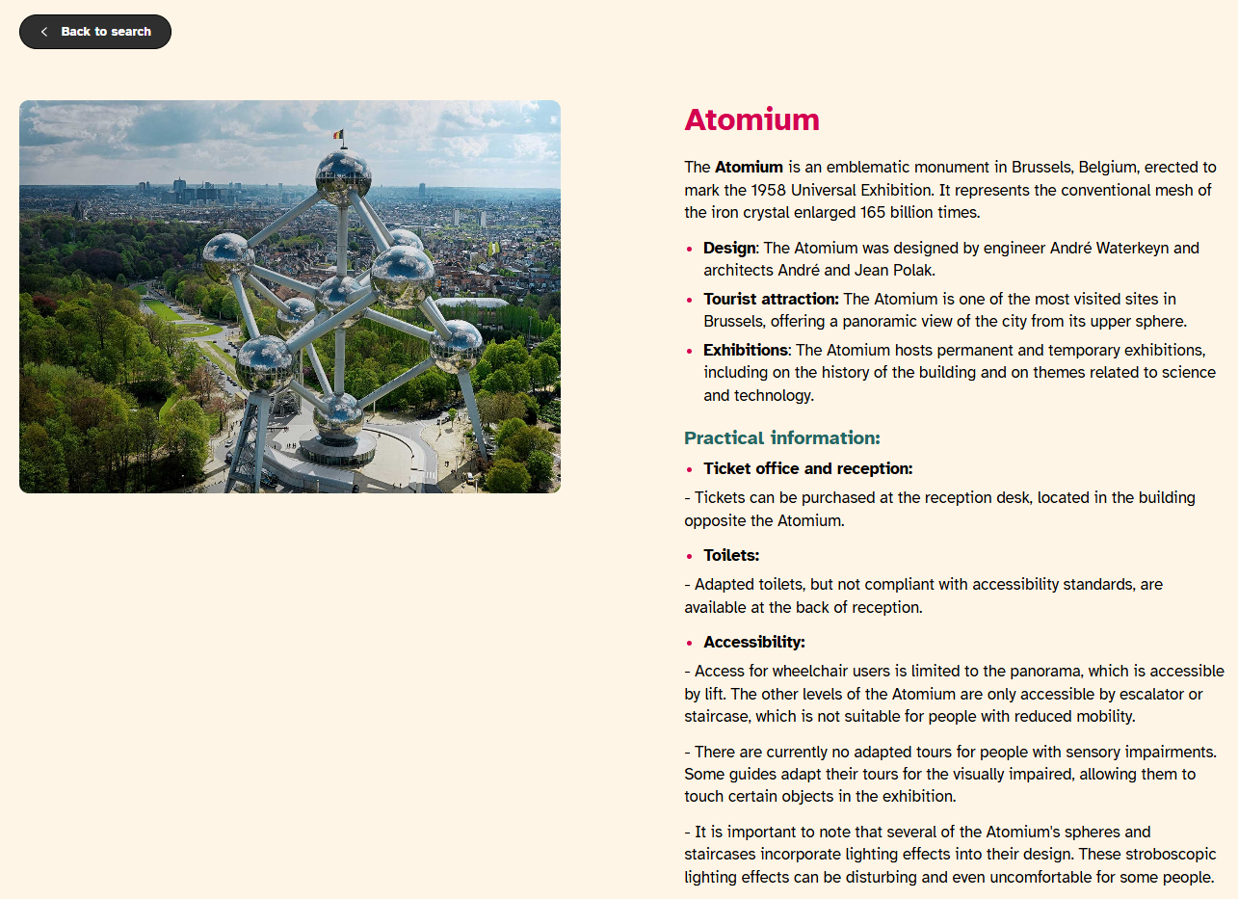
Information page

Slide 7
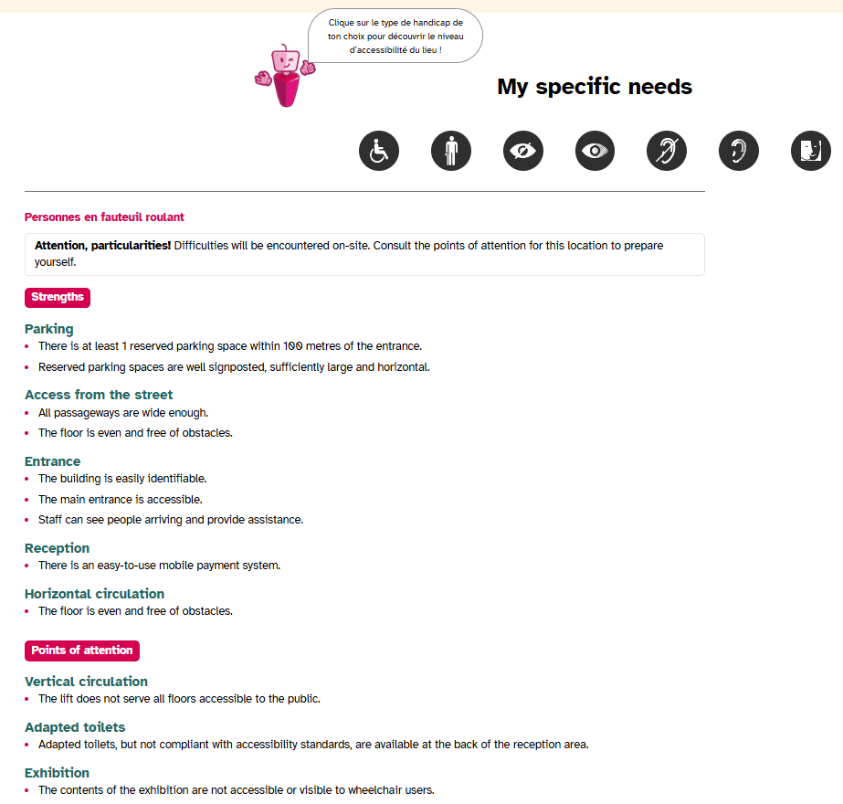
Information page

Slide 8
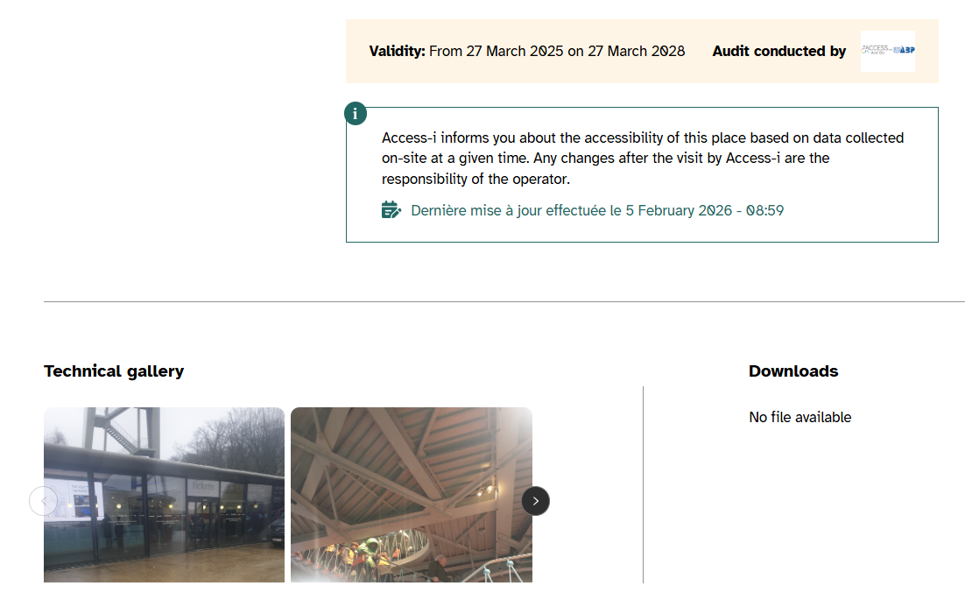
Information page

Slide 9
Renewal of certification
Validity period of a certification =
3 years
(except event)
Purpose = to guarantee the reliability of the information
What's next?
Renewal of certification :
1) No change in 3 years -> declaration on honor + annual fee (60,50 € VAT included)
2) Changes in the structure -> New audit necessary -> 3 years of certification
3) Does not wish to renew -> leaves the Access-i database

Slide 10
2. Information
Our mission = to inform truthfully
Access-i provides reliable and verified information on the accessibility of places open to the general public.
Target audience : 7 disability categories, close caregivers and anyone concerned with accessibility.
How to inform ? 4 channels :
1. On our website : each certified operator has an information page listing the facilities of the place and the possible difficulties that may occur on site.
2. With the certification visual (displayed on the front door, on website and on communication materials).

Slide 11
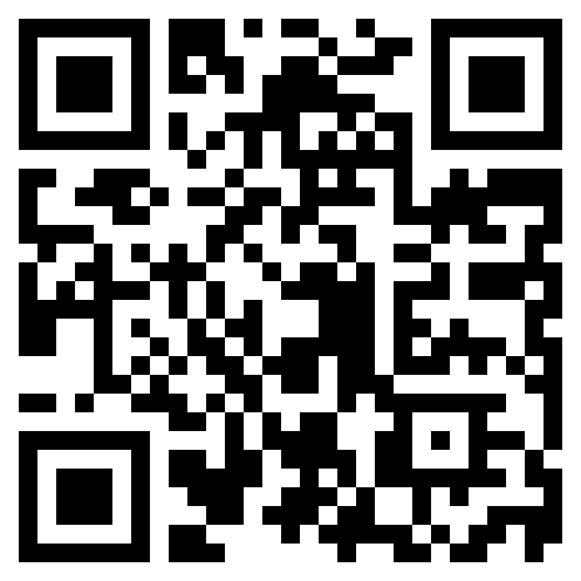
Certification label
Is this infrastructure accessible ?
Three different levels of accessibility :
Accessible ! : I can come alone.
Accessible with occasional assistance ! I have to come with someone.
Be careful, special features ! I have to check the warning information
-> www.access-i.be

Slide 12
2. Information
Our mission = to inform truthfully
Access-i provides reliable and verified information on the accessibility of places open to the general public.
Target audience : 7 disability categories, close caregivers and anyone concerned with accessibility.
How to inform ? 4 channels :
1. On our website : each certified operator has an information page listing the facilities of the place and the possible difficulties that may occur on site.
2. With the certification label (displayed on the front door, on website and on communication materials).
3. On our social networks.

Slide 13
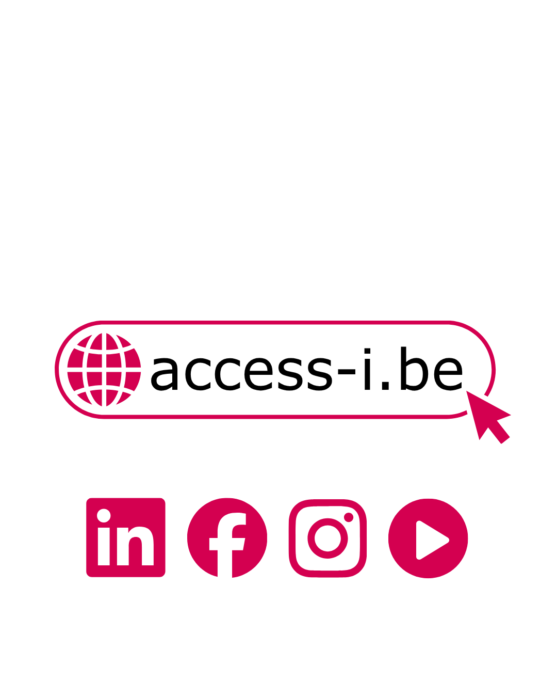

Our social networks
-> Videos in sign language, subtitled, audio-described and with contrasted font.

Slide 14
2. Information
Our mission = to inform truthfully
Access-i provides reliable and verified information on the accessibility of places open to the general public.
Target audience : 7 disability categories, close caregivers and anyone concerned with accessibility.
How to inform ? 4 channels :
1. On our website : each certified operator has an information page listing the facilities of the place and the possible difficulties that may occur on site.
2. With the certification label (displayed on the front door, on website and on communication materials).
3. On our social networks (+ video newsletters).
4. Through our professional network (partners, 6 accessibility consulting companies and 21 CAWaB associations).

Slide 15
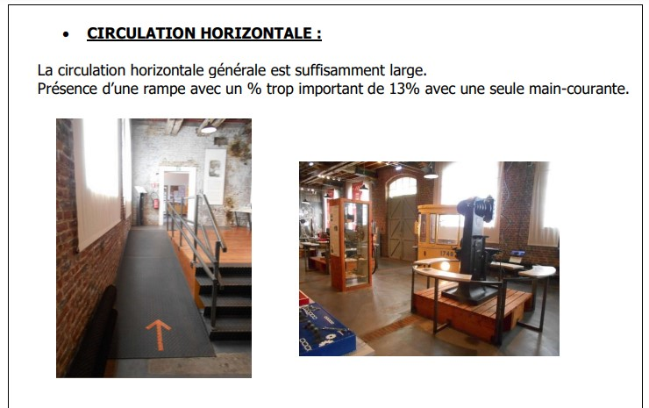
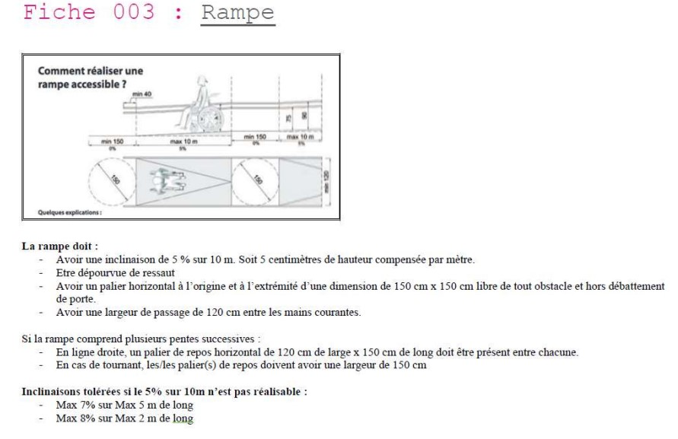
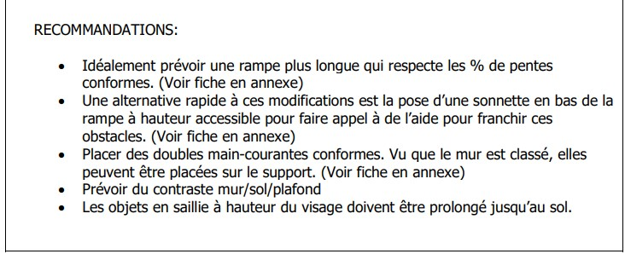
3. Consulting
For operators who want to go further : possibility to ask for recommendations by type of disability in order to maximize the accessibility of the place.

Slide 16
Why get certified ?
Becoming a destination of excellence
Offering a high-quality experience to visitors throughout their visit
Increasing your visibility
Having economic and image benefits
Being part of a sustainable approach
Taking part in an inclusive project
Spreading essential values to staff, collaborators and partners
Being an example in the sector

Slide 17
Access-i offers you :
The promotion of your certification and the highlight of your efforts on our website, our social networks and our videos.
The transmission of information to partners and people with special needs.
An offered training each year on the theme of disability (during the Access-i day).
Tools to help you communicate about your facilities and your certification.

Slide 18
METHODOLOGIES
Criteria based on legislation (CODT/RRU)
Developed for and with users
Buildings
Events
Natural parks
Bike paths
Walking tours (in progress)
Adventure parks
(in progress)

Slide 19
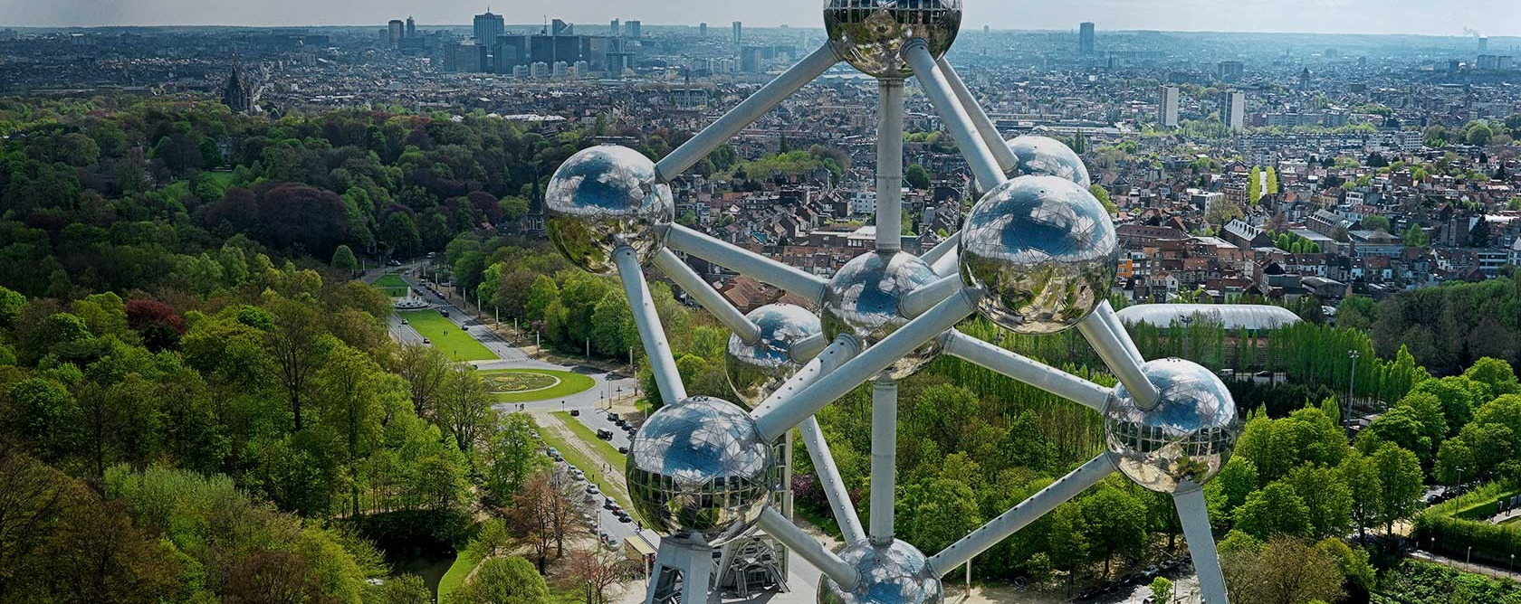
Certified museums and attractions in Brussels
Art and the Margins Museum
Atomium
Autoworld
Belgian Chocolate Village
BELvue
Charlier Museum
Choco Story Brussels
Design Museum Brussels
9. CIVA Foundation
10. MannekenPis Wardrobe
11. Institute of Natural Sciences
12. KBR Museum
13. Ayden's World in Uccle
14. Mini-Europe
15. Comic Strip Museum
16. Museum of Medicine
17. Brussels City Museum
18. Sewer Museum
19. Fashion & Lace Museum
20. Hal Gate
21. Train World (in progress)
22. Royal Army Museum (in progress)
23. The French Fry Museum (in progress)

Slide 20
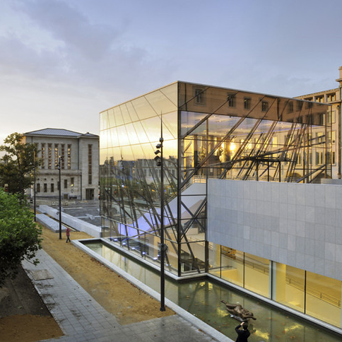
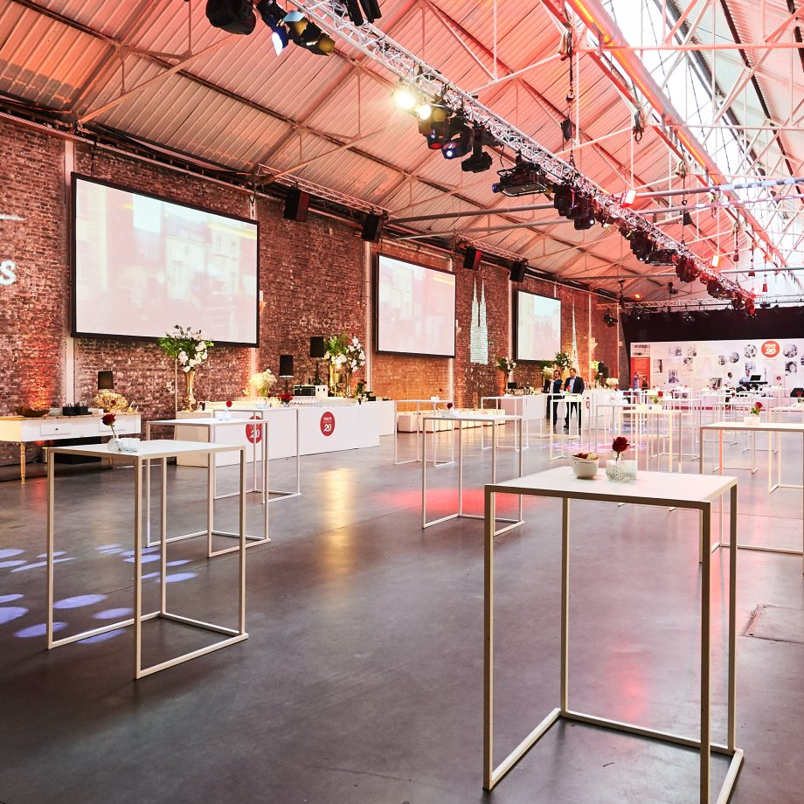
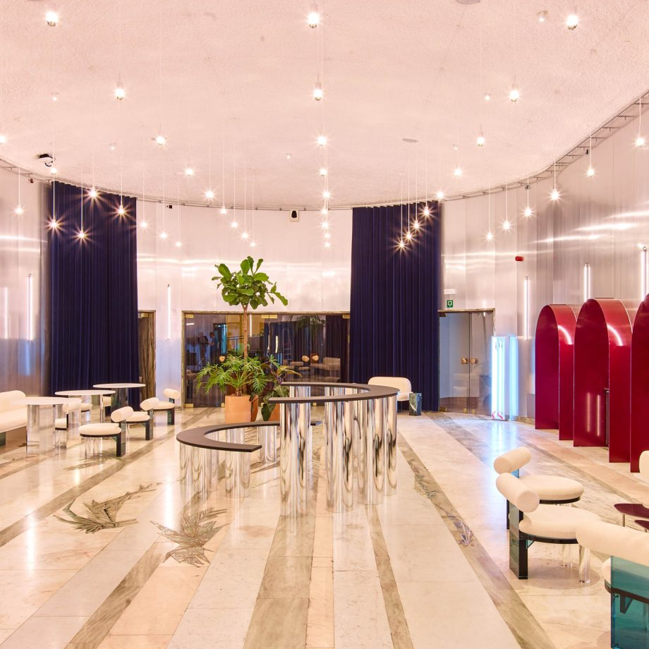
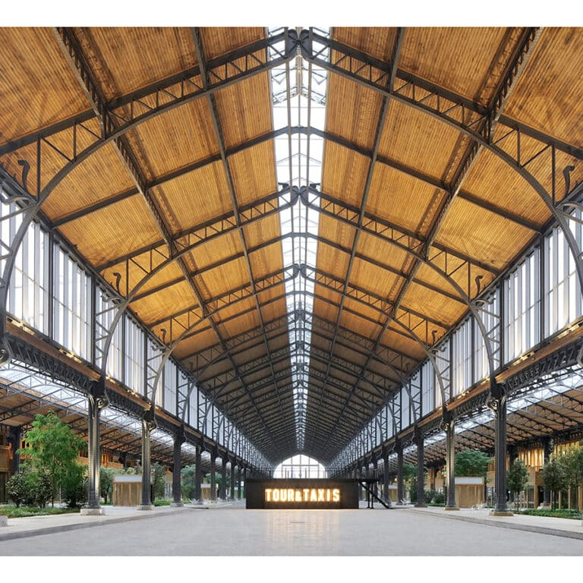

Brussels Special Venues
16 Venues certified by Access-i :
BE-HERE
BIP Meeting Center
Dome Eventhall (Docks Dome)
The Tricoterie
Les Ateliers des Tanneurs
SILO Brussels
SPARKS Meeting
Square-Brussels Convention Centre
The Egg
The Faculty
Tour & Taxis – Maison de la Poste
Tour & Taxis – Gare Maritime
Tour & Taxis – The Sheds
Flylounge (in progress)
The Market Halls of Schaerbeek (in progress)
SOMA FOUNDATION (in progress)
© Square-Brussels
© The EGG
© Sparks Meeting
© Gare Maritime

Slide 21
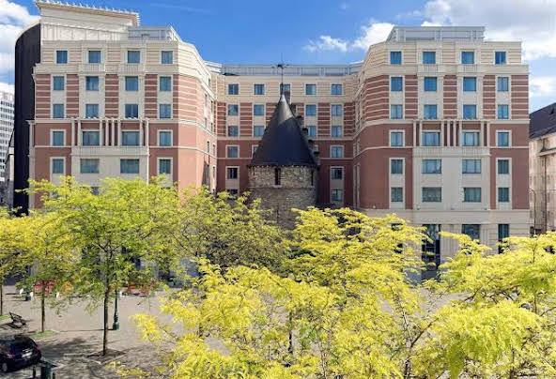
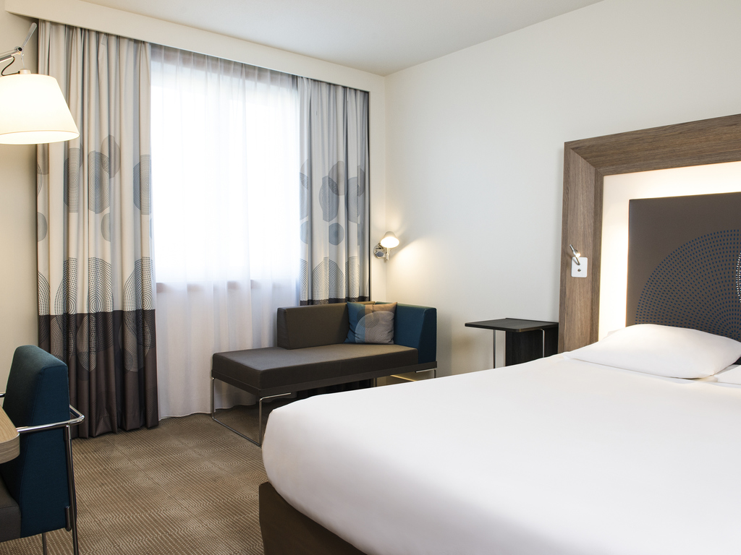
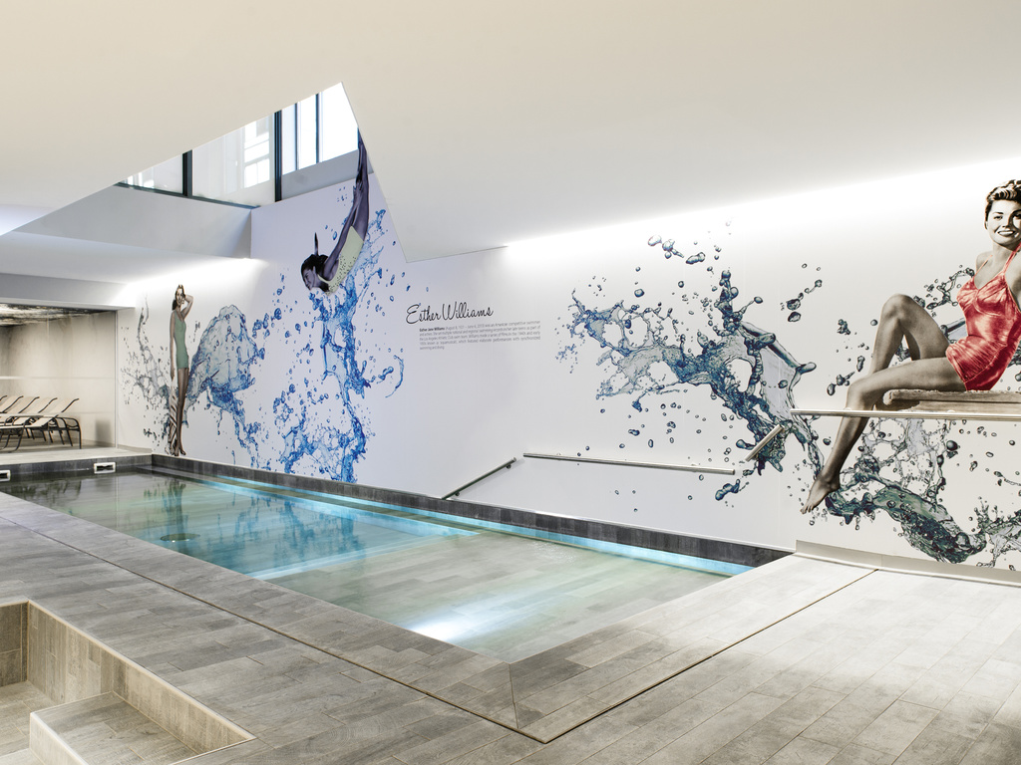
Accommodation
Novotel Brussels City Centre
Radisson Collection Hotel Grand Place Brussels
Pullman Brussels Centre Midi
Jacques Brel Youth Hostel
Pestana Brussels Schuman
Sofitel Brussels Europe
The Hotel
The Liman Hotel
Thon Hotel
Corinthia Grand Hotel Astoria (in progress)
© Novotel
© Novotel
© Novotel

Slide 22
METHODOLOGIES
Criteria based on legislation (CODT/RRU)
Developed for and with users
Buildings
Events
Natural parks
Walking tours (in progress)
Adventure parks
(in progress)
Bike paths

Slide 23



Agreement with visit.brussels in 2026

Slide 24
METHODOLOGIES
Criteria based on legislation (CODT/RRU)
Developed for and with users
Buildings
Events
Bike paths
Natural parks
Walking tours (in progress)
Adventure parks
(in progress)

Slide 25
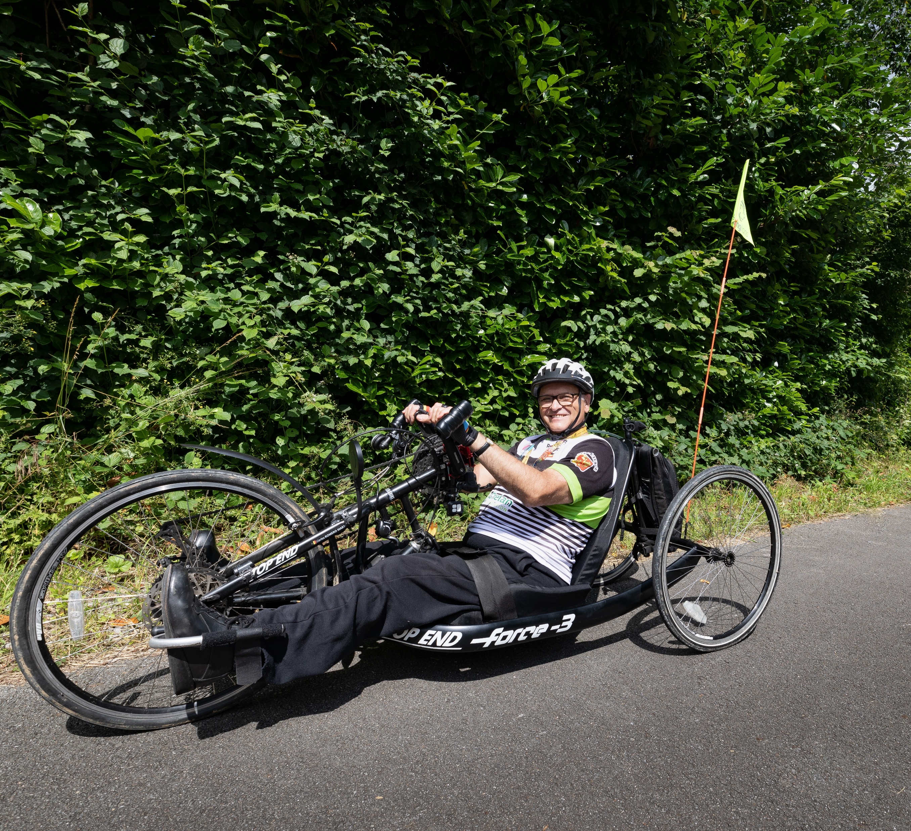
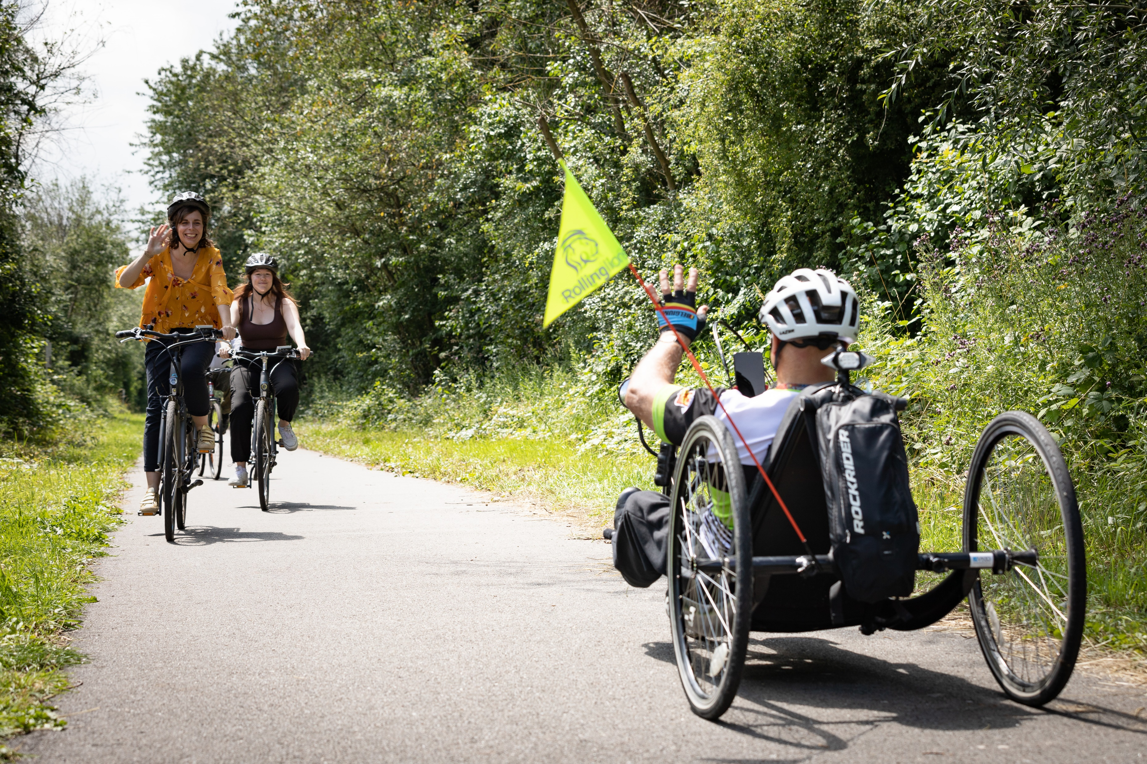

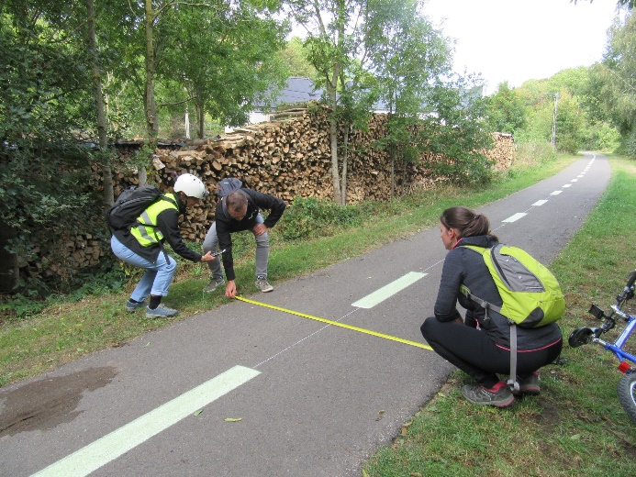

Bike Paths
© Bruno d’Alimonte - WBT
In total, since 2019, 34 bike paths have been certified !
In Brussels :
Two certified bike routes :
Sonian Forest (21 km)
Jette – Laeken (8 km)
© Bruno d’Alimonte - WBT
© Access-i Asbl

Slide 26
METHODOLOGIES
Criteria based on legislation (CODT/RRU)
Developed for and with users
Buildings
Events
Bike paths
Natural parks
Walking tours (in progress)
Adventure parks
(in progress)

Slide 27

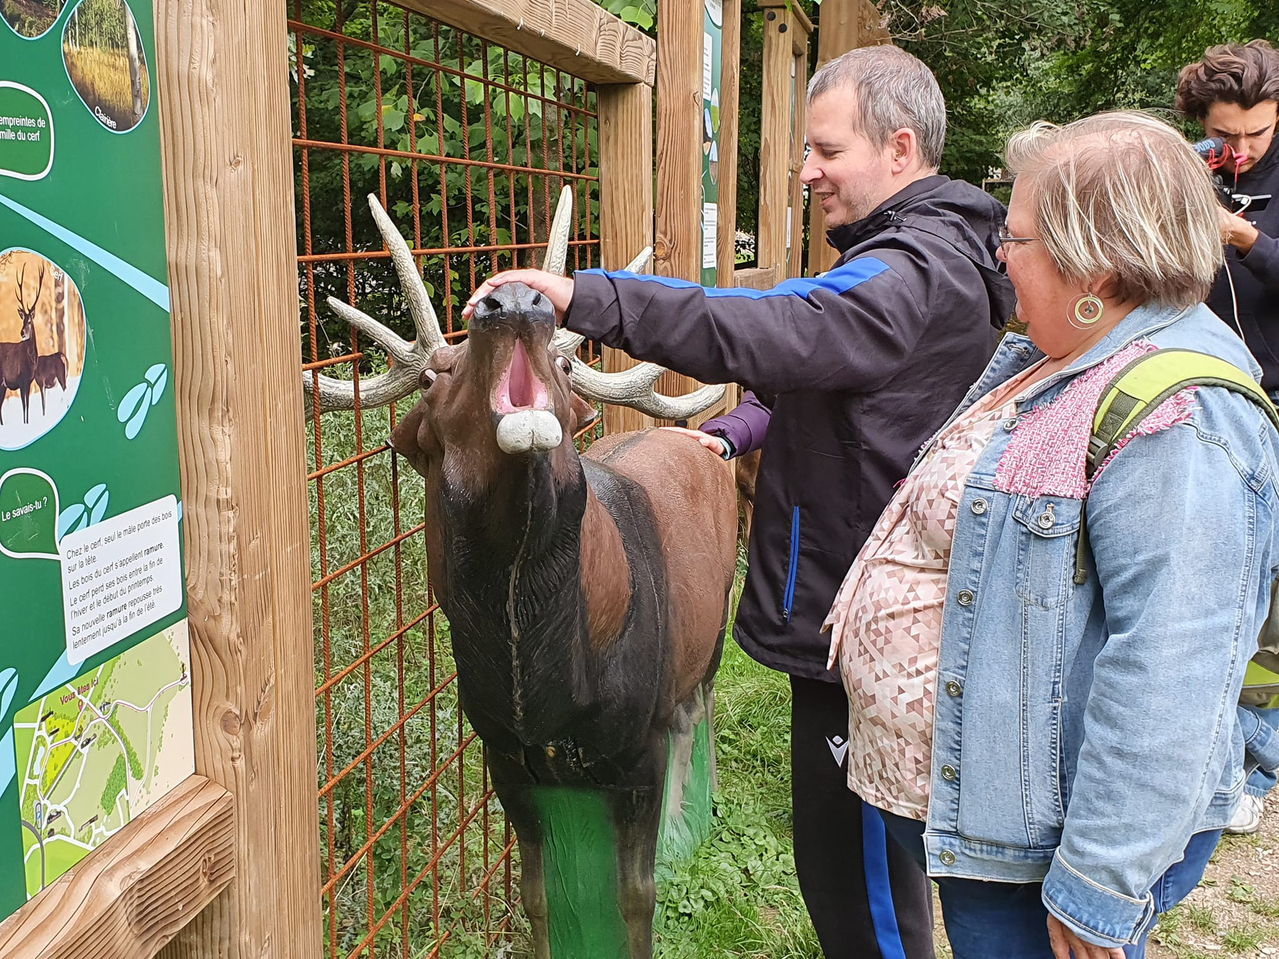
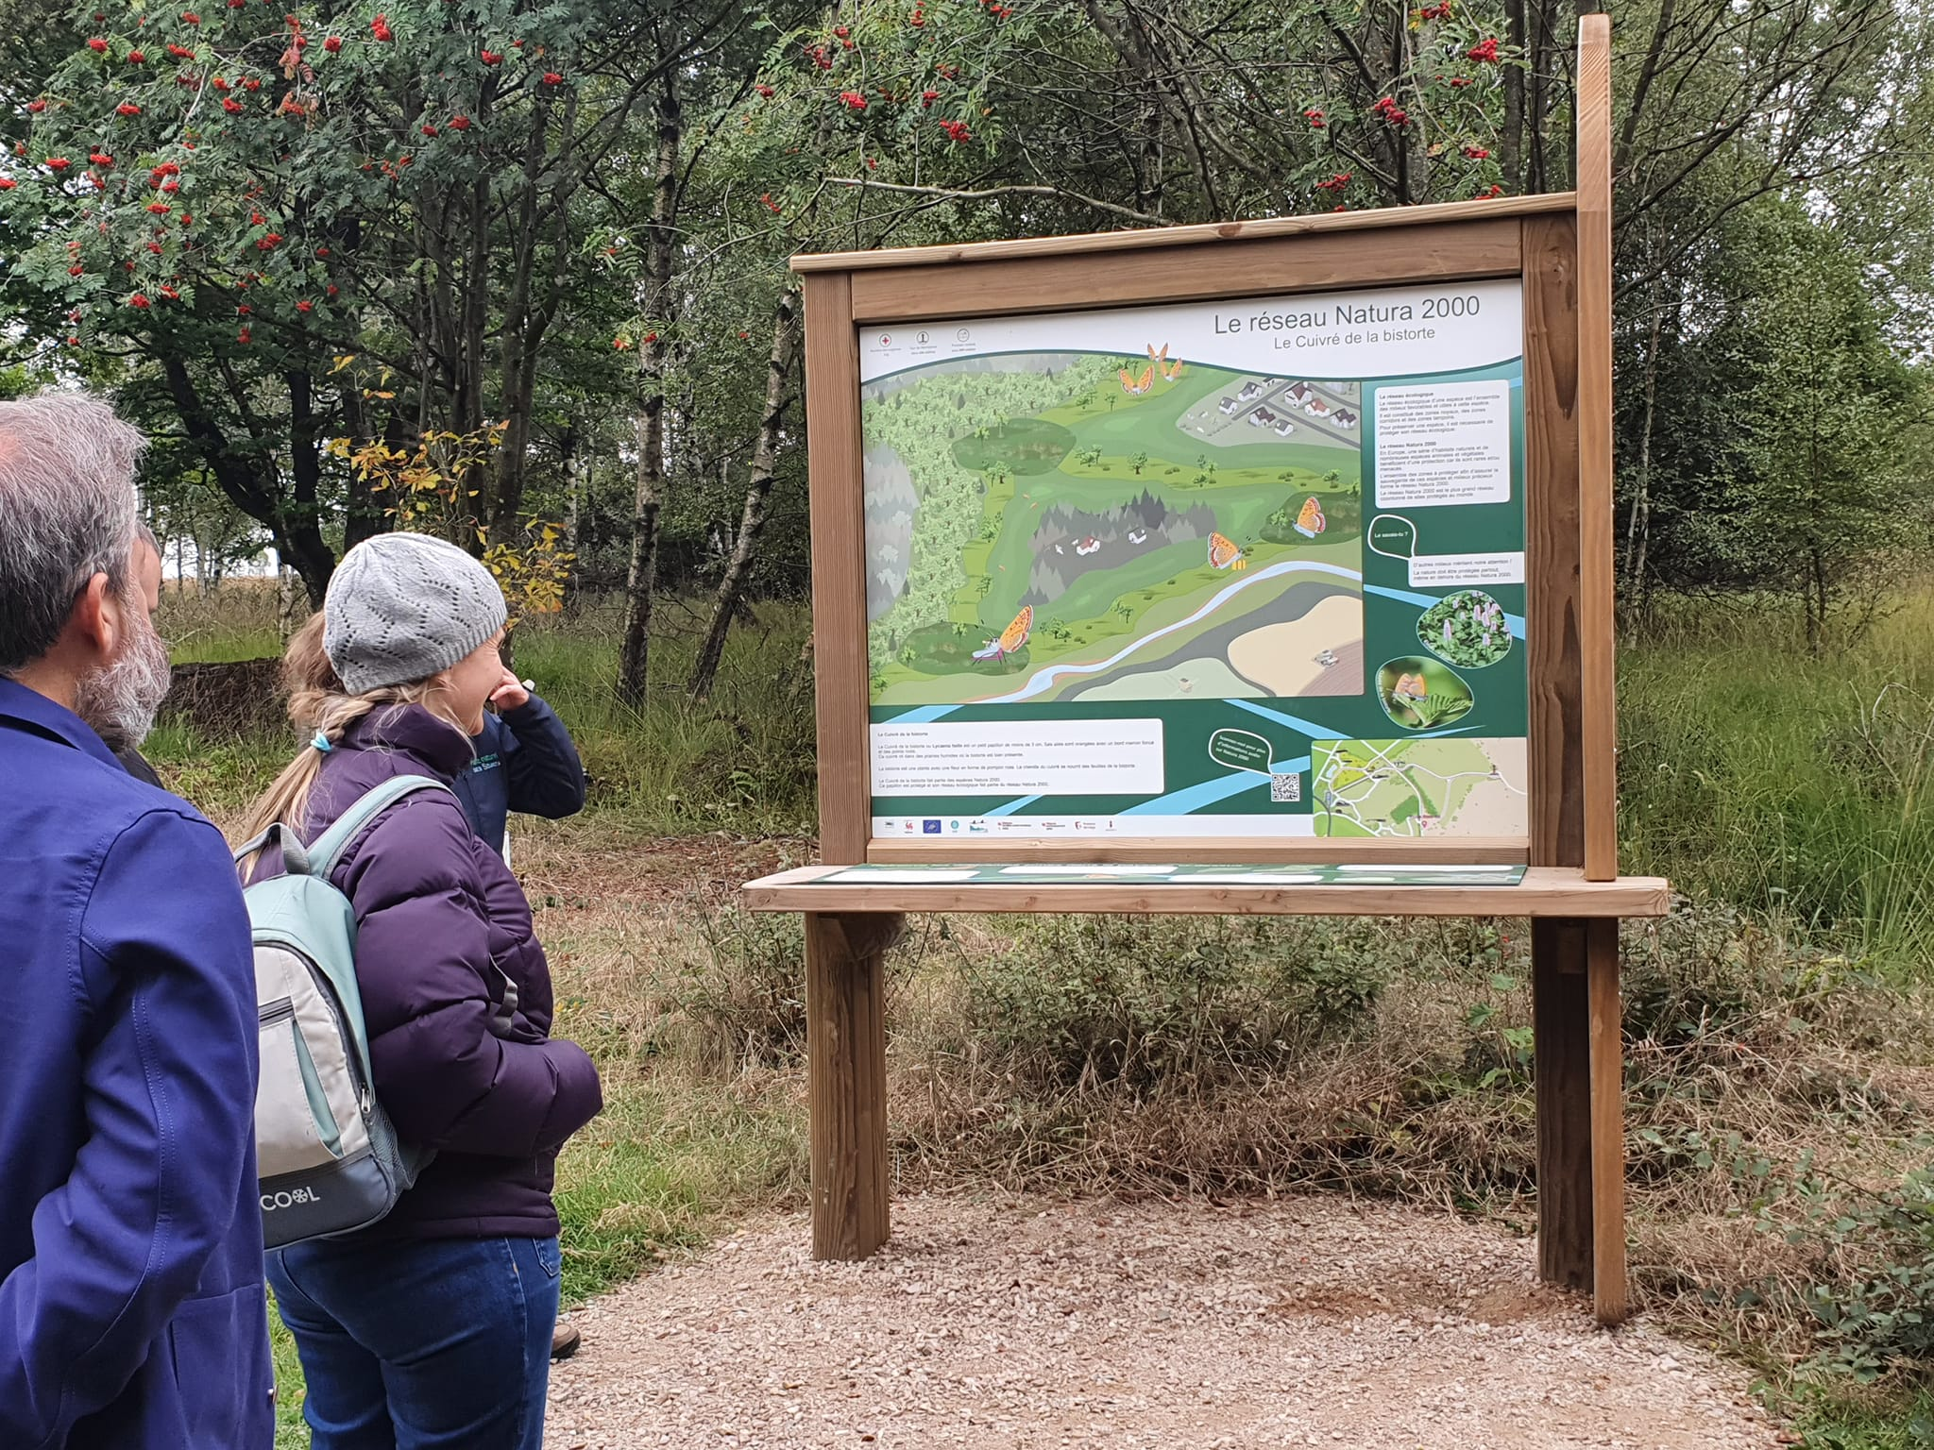
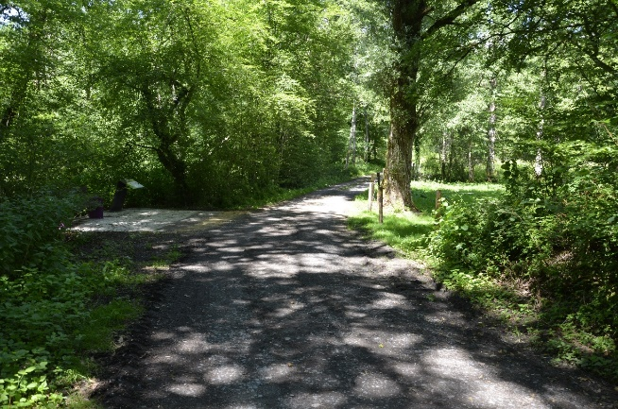
Natur’Accessible
Since 2018, Access-i has been working with the Federation of Natural Parks of Wallonia to transform forest paths to make them accessible to people with special needs.
8 natural parks have been certified :
Vallée de l'Attert natural park
Viroin-Hermeton natural park
Hautes Fagnes-Eifel natural park
Gaume natural park
Plaines de l’Escaut natural park
Pays des Collines natural park
Les deux Ourthes natural park
Burdinale-Mehaigne natural park
© FPNW
© Access-i Asbl
© Access-i Asbl
© Access-i Asbl

Slide 28
METHODOLOGIES
Criteria based on legislation (CODT/RRU)
Developed for and with users
Buildings
Events
Bike paths
Natural parks
Walking tours
Adventure parks
Methodological adjustments and evolution + continuous training

Slide 29
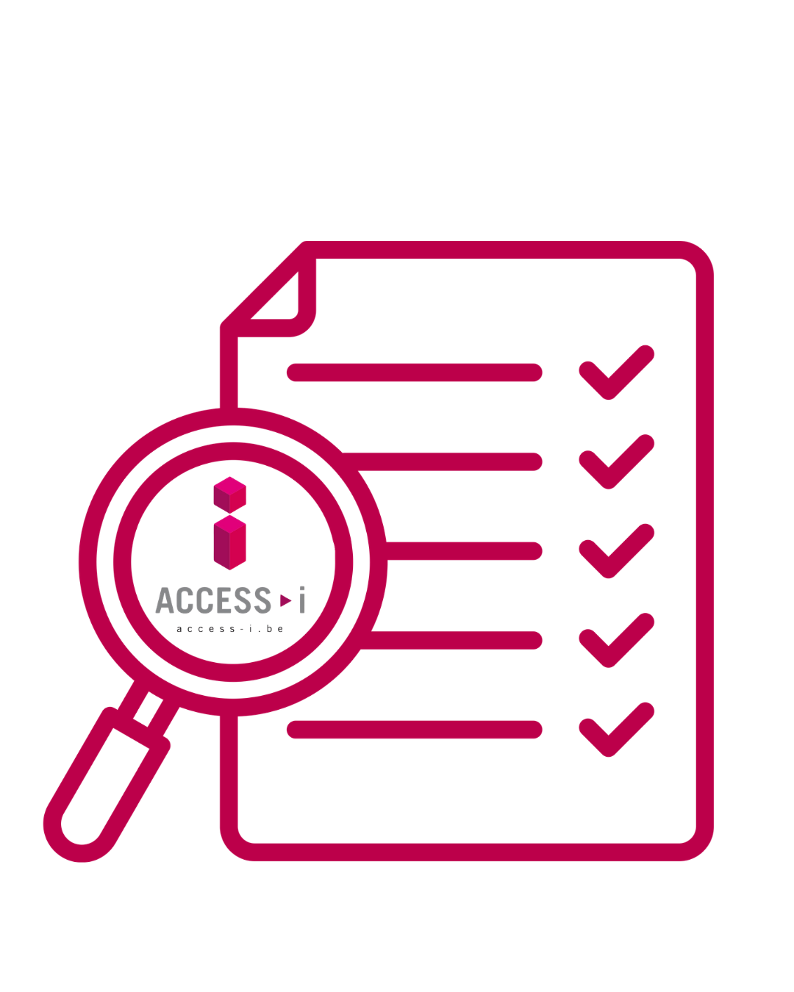
Costs of Access-i services
The price depends on the size and complexity of the infrastructure.
For an audit and recommendations (building) :
Small : from 636,00 € without VAT
Medium : from 860,00 € without VAT
Large : from 1.309,00 € without VAT
For an audit and certification (building):
Small : from 562,00 € without VAT
Medium : from 748,00 € without VAT
Large : from 935,00 € without VAT

Slide 30
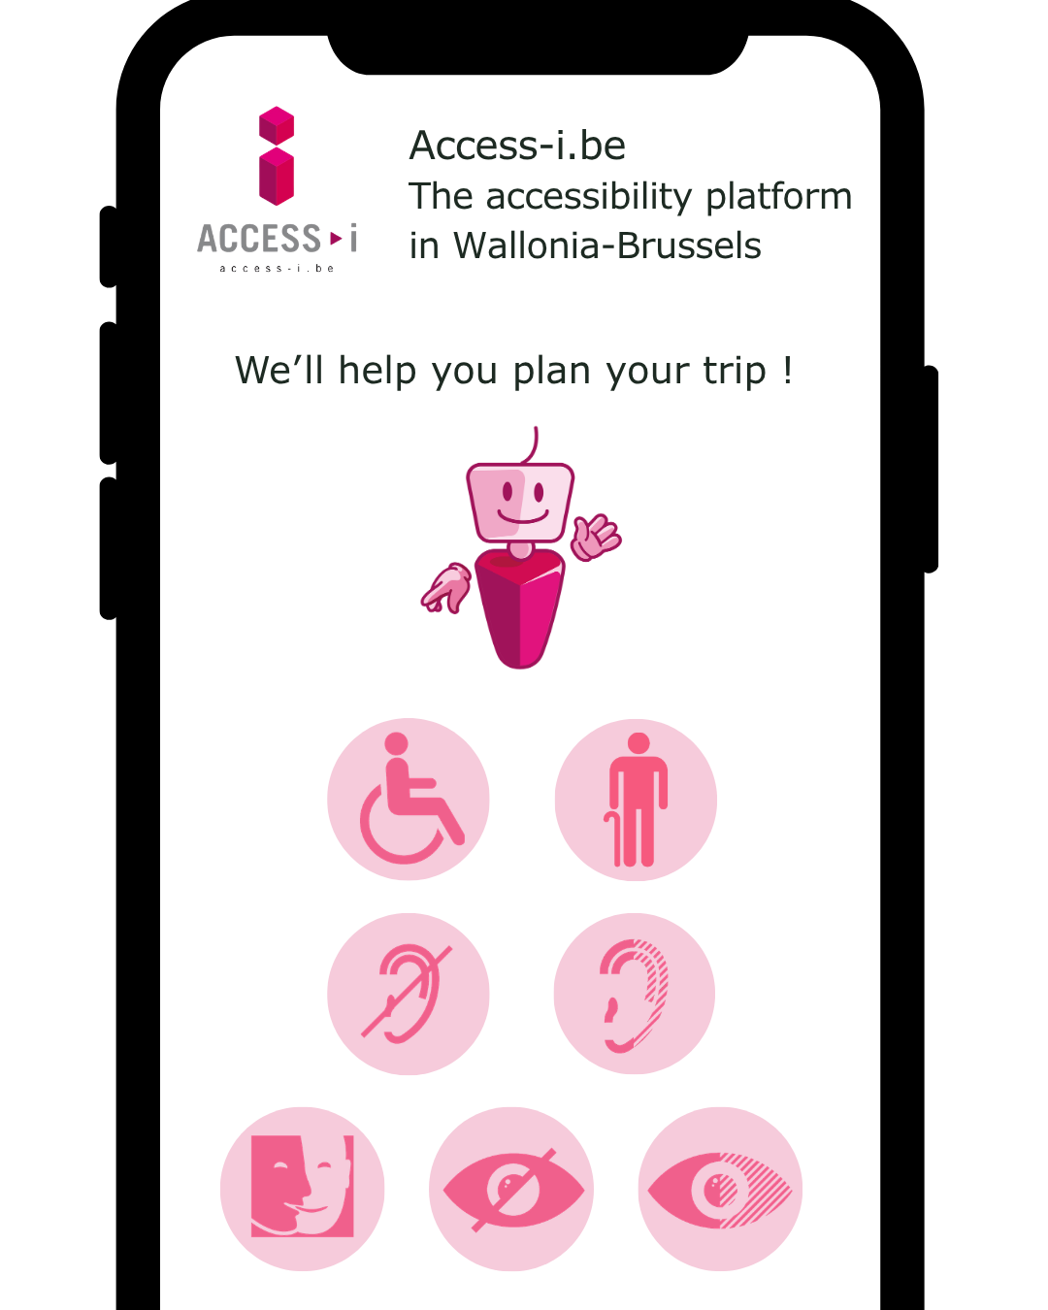


Access-i, THE accessibility platform !
2024 : creation of a new digitally accessible website for all types of disability (voice synthesis, contrast, zoom, FALC, sign language).
Official launch during a press conference at Lac de Bambois with Ministers Yves Coppieters and Valérie Lescrenier.

Slide 31
Testimony

Slide 32

Rue Nanon,98 in 5000 Namur
081 39 08 78
axelle.brygo@access-i.be

