Slide 1
GREEN KEY
20/04/2026
WWW.GREEN-KEY.BE
Notes:
Introduction of ourselves –
agenda
Benefits of operating more sustainably
What is Green Key?
Application process

Slide 2

Agenda
  Benefits of being eco-certified
  What is Green Key ?
  Green Key in Belgium
  Why Green Key ?
  The criteria
  The application process
Notes:
Helen

Slide 3
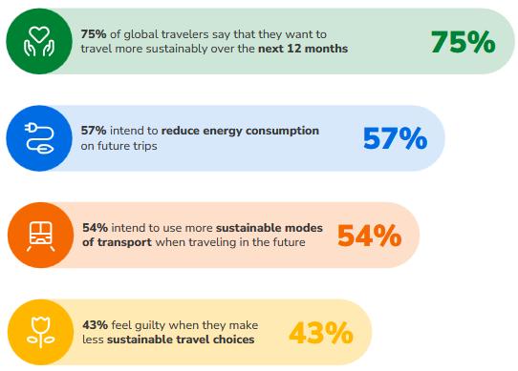
Changing course, but why?
1. Responding to tourists' demand
Sustainable travel report, Booking 2024
Notes:
Eloïse

Slide 4

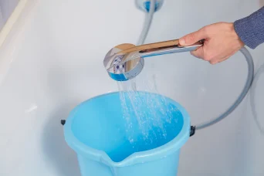
The benefits for you
2. Lower operating costs by saving water, energy and waste
Notes:
Eloïse

Slide 5
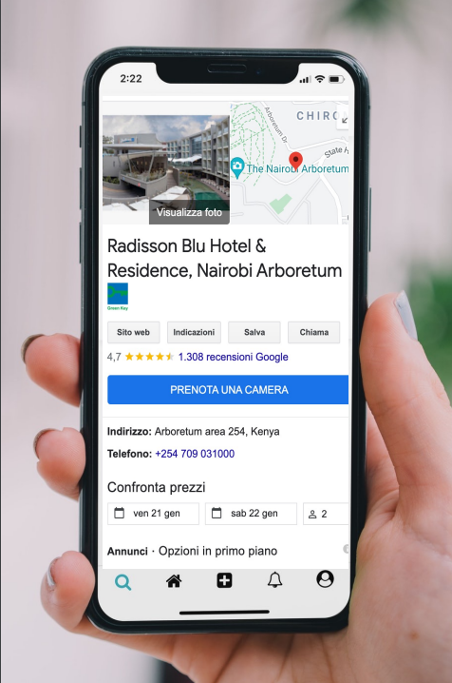
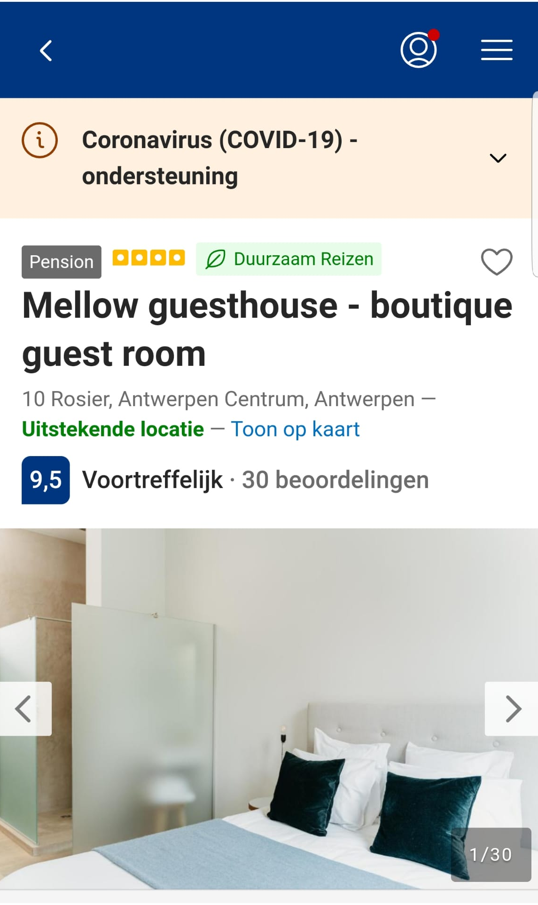

The benefits for you
3. Competitive advantage
Distinguish your establishment with a sustainable narrative
Several OTAs mention sustainable initiatives on their search page
Accept ecocheques if you have achieved the Green Key sustainability label.
Notes:
Eloïse

Slide 6
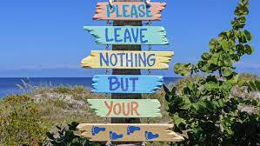
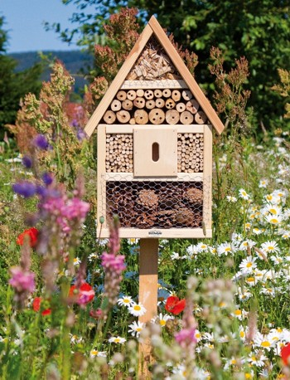
The benefits for you
4. Contribute to preserving our environment
Contribute to climate goals and a future-proof tourism sector.
Inspire travelers (even unconsciously) to behave sustainably reduces the impact of the sector and ensures its future.
Notes:
Eloïse

Slide 7

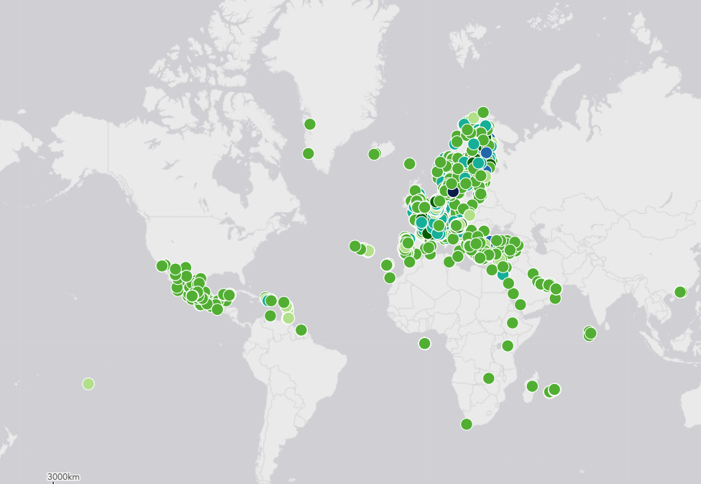
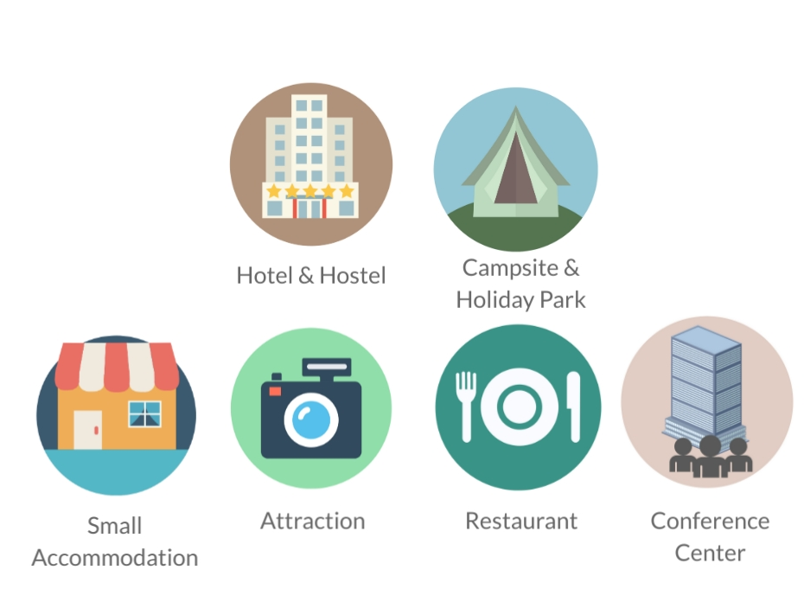
What is Green Key?
International eco-label for the tourism industry
  Foundation for Environmental Education (FEE)
  8000+ certified establishments / 90+ countries
Notes:
Helen

Slide 8
Green Key Belgium
Green Key in Belgium is coordinated by two national operators:
GoodPlanet Belgium for Flanders and Brussels (NL)
Canopea for Wallonia and Brussels (FR)
Belgium has 402 Green Key locations
  219 in Flanders (GoodPlanet)
  105 in Wallonia (Canopea)
  78 in Brussels
Notes:
Helen

Slide 9
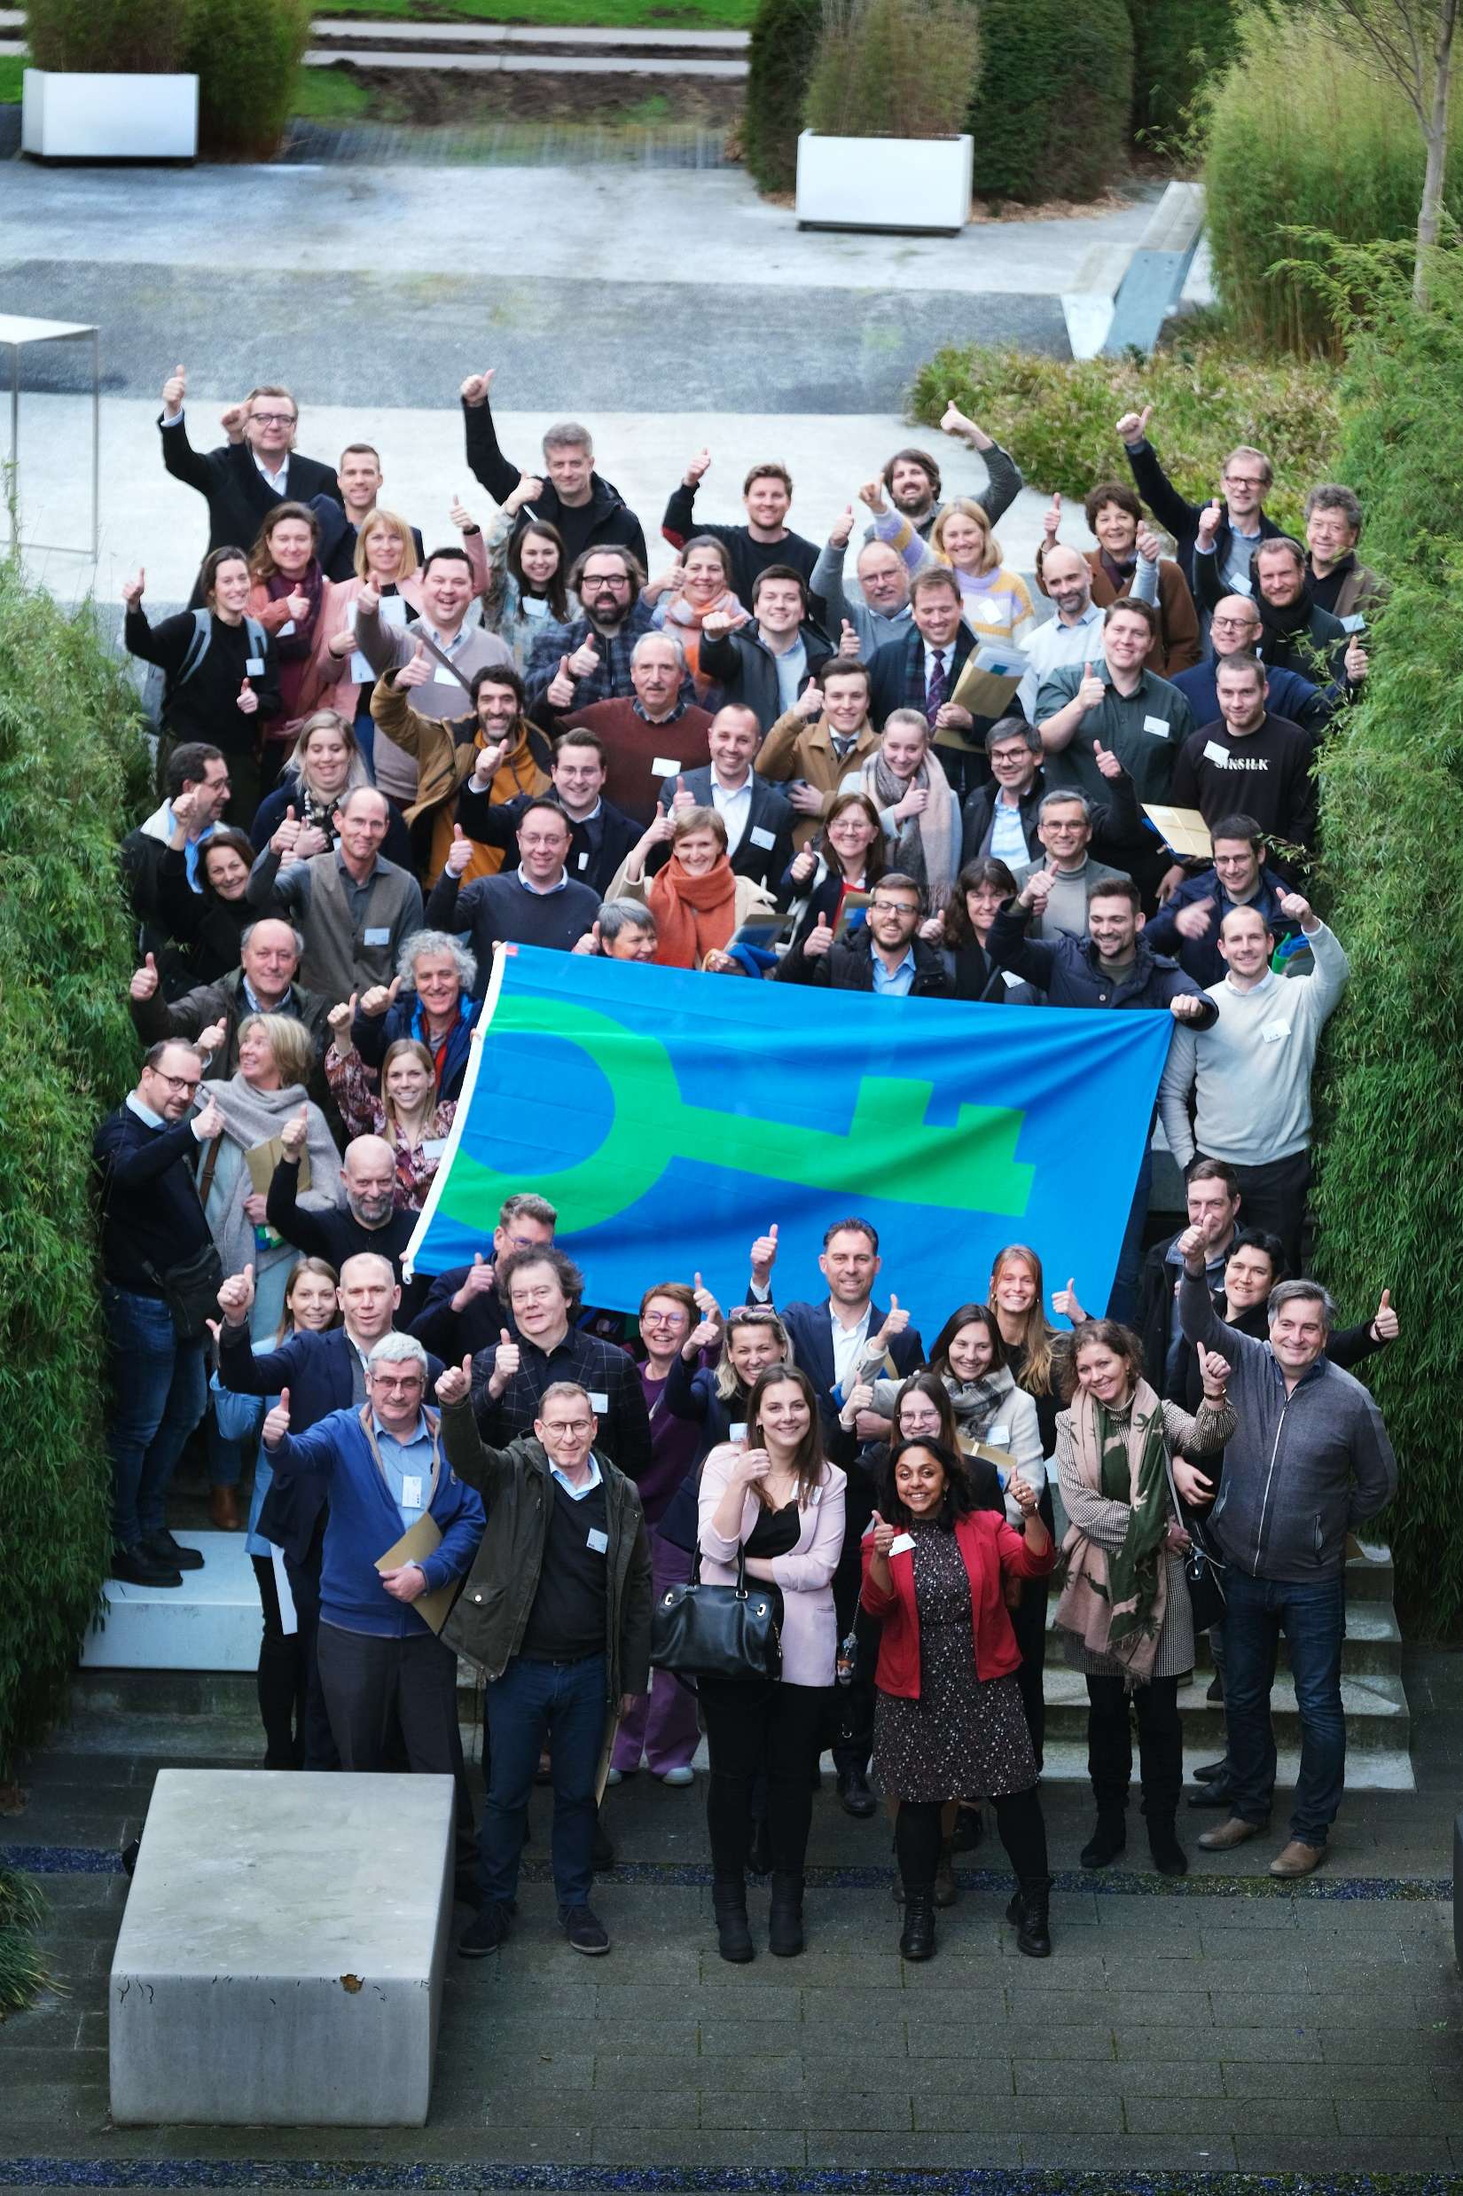
Why Green Key?
Added value for establishments
Supports and unites operators who want to make their
establishment more sustainable
Framework for sustainable operation
Green Key works with external environmental experts
who give on-site advice
International recognition for sustainable efforts
Green Key is the largest tourism label in Belgium
Notes:
Helen

Slide 10
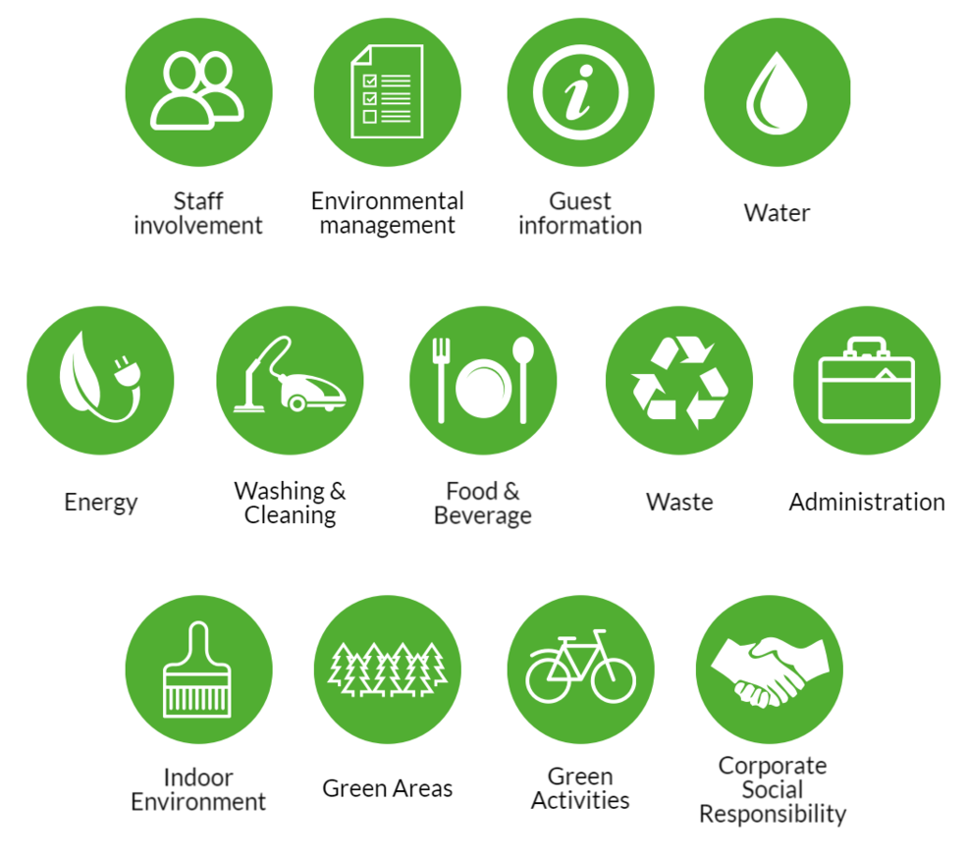
Green Key criteria
International criteria
Most ambitious standard
Review of criteria every four years – new set now!
Download the criteria on our website www.green-key.be
Notes:
Helen

Slide 11
Green Key criteria
Registration of water and energy consumption, waste registration and carbon calculation.
Implementation of energy- and watersaving measures:
Energy: LED lighting, control systems for heating, ventilation and air-conditioning, energy efficient devices, taps and showers have systems to reduce water flow, wastewater is treated, rainwater is collected (guideline), etc.
Waste prevention and sorting: single-use tableware products are not used, waste separation in at least 3 categories, max. five food/beverage products in individually packaged single servings, toiletries are provided in dispensers, etc.
Ecological cleaning:
Informing guests about routine for change of towels, toilet paper and paper towels need to have eco-label, etc.
Notes:
Helen

Slide 12
Green Key criteria
Sustainable food and beverage:
At least 5 types of food/beverage needs to be organic, eco-labelled, fairtrade or local, initiatives to reduce food waste, inform guests about which products are local/bio/fairtrade/etc.
Declaration of corporate social responsibility:
Formulate a sustainability policy, annual action plan, collaboration with relevant local stakeholders, etc.
Education of staff and encouraging guests to reduce the environmental impact of their stay.
Attention to green maintenance and supporting biodiversity.
Download the criteria on our website
Notes:
Helen

Slide 13
Application process
1
2
3
Online meeting with Green Key team
Fill in the application on www.green-key.be
Send your confirmation of the application to green-key@goodplanet.be or green-key@canopea.be
Deadlines:
First round: 15/09
Second round: 15/03
Timing proces:
Notes:
Eloïse

Slide 14
Application proces
4
5
6
7
Audit by an external auditor
Send your proof of any made changes to the auditor and Green Key team
The application is approved by the certification body
Green Key award event
Timing proces:
1st: october/november
2nd : april
1st: december
2^{nd :} may
Notes:
Eloïse

Slide 15
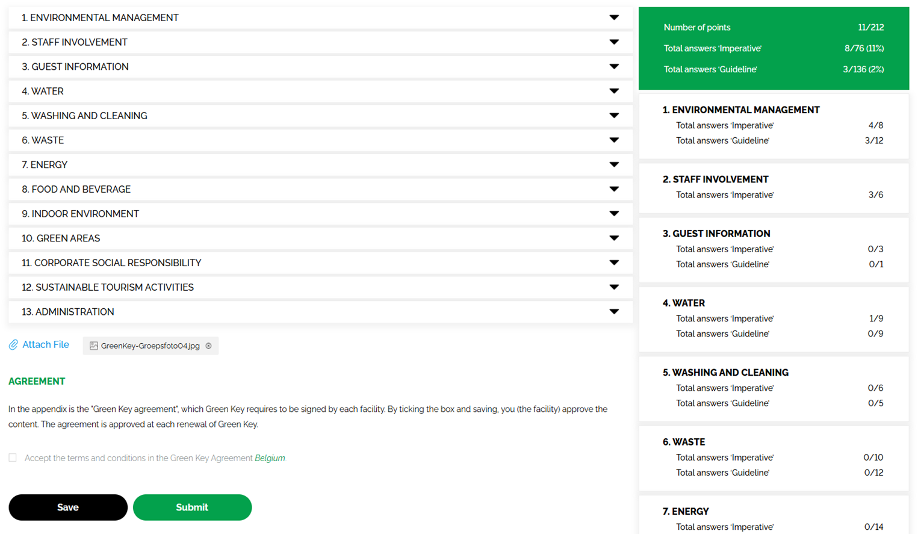
Application tool
Notes:
Helen

Slide 16
Costs overview
You can find the cost overview on our website www.green-key.be
Notes:
Eloïse

Slide 17
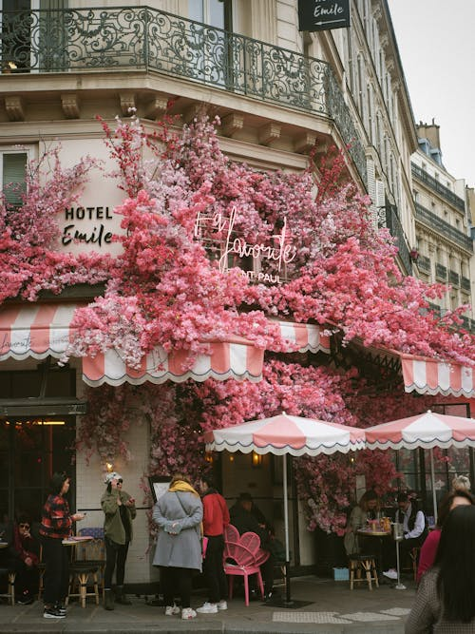
Example: Boutique Hotel Emile
Family hotel with 45 rooms
Located in the city center of Brussels
Started with the application for Green Key in Brussels
Noticed during application process that they did not yet comply to all mandatory criteria:
  No flow restrictor or water-saving shower heads
  No LED lights
Green Key team informs hotel owner about financial support from Brussels exemplarité and the Ecodynamic Organisation Label
→ Possibility to start journey to Green Key with Ecodynamic Organisation Label to be eligible for Brussels Exemplarité

Slide 18


CONTACT US
More information: www.green-key.be
GoodPlanet Belgium (NL)
Helen Van der Maat
green-key@goodplanet.be
0473 13 45 76
Canopea (FR)
Eloïse Pirson
green-key@canopea.be
0476 915 882

