Slide 1

2026

Slide 2


The first global LGBTQ+
tourism distribution platform
We are a global agent of transformation that promotes inclusion as a strategic, social, and economic value. As the first global distribution platform for LGBTQ+ tourism, we connect education, standards, and business to create a more accessible, safe, and prepared tourism ecosystem that meets the real needs of this segment.
15
Countries
38
Cities
5
Sectors

Slide 3


More than 23.5% of Gen Z adults report an LGBTQ+identity
Generational Potential
More Loyal
More Digital
New generations use technological tools to seek unique and safe experiences.
10%
A segment that represents 10% of the world's population.
Inclusive destinations generate more repeat visits and recommendations.

Slide 4


Social Potential
Countries with inclusive policies have a higher approval rating at the national and international levels.
6-22%
+20%
Economic potential unleashed
An inclusive country can unlock up to 20% of the economic potential lost due to discrimination.
Cities with inclusive policies achieve...*
Negative impact on GDP
This impact can be explained by stigmatization and exclusion, demonstrating that inclusion drives economic development.
x4
Human capital performance
x2Innovation
x2.5Entrepreneurship
* Compared to less inclusive cities.

Slide 5










The Global LGBTQ+ Distinction
We are the only LGBTQ+ distinction recognized globally by major companies and organizations.

Slide 6
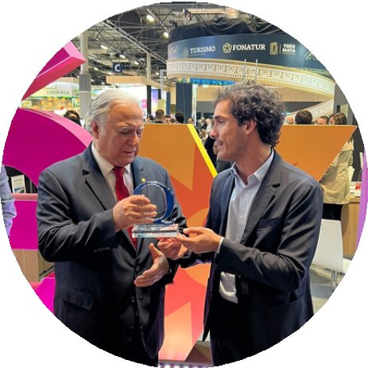
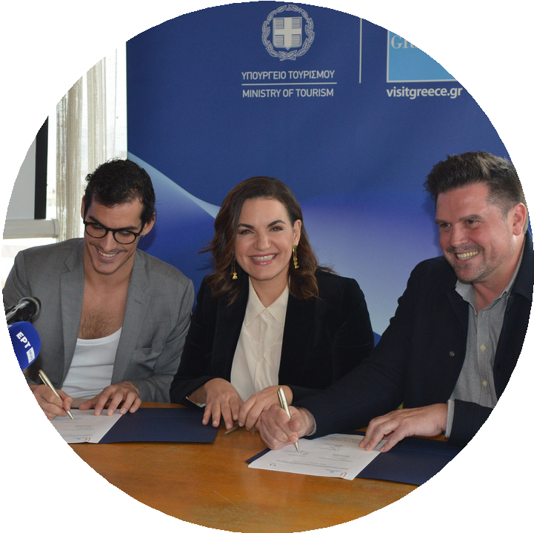







Country-Level Strategies
Mexico
Greece
Spain
The Secretary of Tourism, Miguel Torruco Marqués, signed a collaboration agreement with QD to develop a destination strategy aimed at positioning Mexico in the international market as a leading destination for LGBTQ+ travelers.
Greek Tourism Minister Olga Kefalogianni signed a letter of intent with Queer Destinations to promote Greece as an inclusive and safe destination for LGBTQ+ people, reinforcing its international positioning in diverse and responsible tourism.
The Minister of Industry, Trade and Tourism, Reyes Maroto, signs an international agreement during FITUR 2023 with Oriol Pàmies, founder of Queer Destinations, to promote the first national tourism strategy focused on the LGBTQ+ segment in Spain.

Slide 7
Benefits
Differentiation
Training
Community
Real differentiation from the competition in an increasingly saturated market.
Comprehensive training in DEI, with verifiable standards applicable to the business.
Access to a global community of over 50,000 active people.
Reach
Distribution
Visibility
Participation in marketing campaigns with a reach of up to 35 million people.
Distribution platform for direct sales, connecting your supply with LGBTQ+ demand.
Influencer and media programs that amplify visibility, trust, and conversion.

Slide 8

Our Ecosystem
A model where every stakeholder wins: better institutional perception, better tourist experience, more business, more social impact, and better economic results.
Governments
Destinations
Private companies
Communities (with social impact and donations)
Global distribution

Slide 9

Our Method
Building a genuine approach to the LGBTQ+ community in 4 steps.
Commitment
Awareness
Distribution
Implementation
Communication, Marketing and Public Relations
Communication

Slide 10






Certifiable sectors
Queer Destinations Committed
Education
Tourism
Health
Trade
Society

Slide 11





Distribution Platform
Powered by HBX Group
Endorsed by governments, leading brands, and now by the world's largest tourism distribution infrastructure, our distinction is now further supported by the world's largest tourism distribution technology infrastructure. The platform offers:
Priority visibility of certified inventory
Access to agencies, OTAs, tour operators and B2B channels
Specific segmentation for LGBTQ+ travelers
Data intelligence and demand

Slide 12

QDC Distinction
Requirements:
1
Designation of a Queer Champion
Person responsible for leading LGBTQ+ engagement within the organization.
2
100% team awareness
Mandatory training for all staff through Hospitality Meets Diversity.
3
Non-discrimination policy
Implementation of a clear internal and external policy.
4
Audit and evaluation
Passing the audit process and achieving the minimum required score.

Slide 13

































Destinations
Accommodations
Restaurants
Transport
© 2025 Qu©ee²r⁰D²e⁶s^{Q}tin^{u}a^{e}t^{e}io^{r}n^{D}s^{e}A^{s}l^{t}l ^{i}r^{n}ig^{at}h^{i}tºs^{n}r^{s}e.served.
All rights reserved.

Slide 14




















Culture
Events
Local activities and unique experiences
Travel agencies, tour operators and distributors

Slide 15

Smart Tourism
A model where all parties involved win: the visitor gains access to safe and reliable services; the government strengthens standards and order; companies differentiate themselves, increase their competitiveness and generate more income; and communities participate in responsible development.
The strategic capture of the LGBTQ+ segment, a market with an estimated economic impact of more than USD 65 billion annually, average spending up to 20–25% higher than that of the traditional tourist, trips with higher consumption per night and less dependence on seasonality, since they travel constantly throughout the year.
It's not just visibility: it's a strategic tool for sustainable and profitable growth, improving the end customer experience, optimizing team productivity, and strengthening the reputation of organizations.

Slide 16
Committed Queer Destinations

